Slide 1
Median Rest and Move Laterality Results
Sid Rana

Slide 2
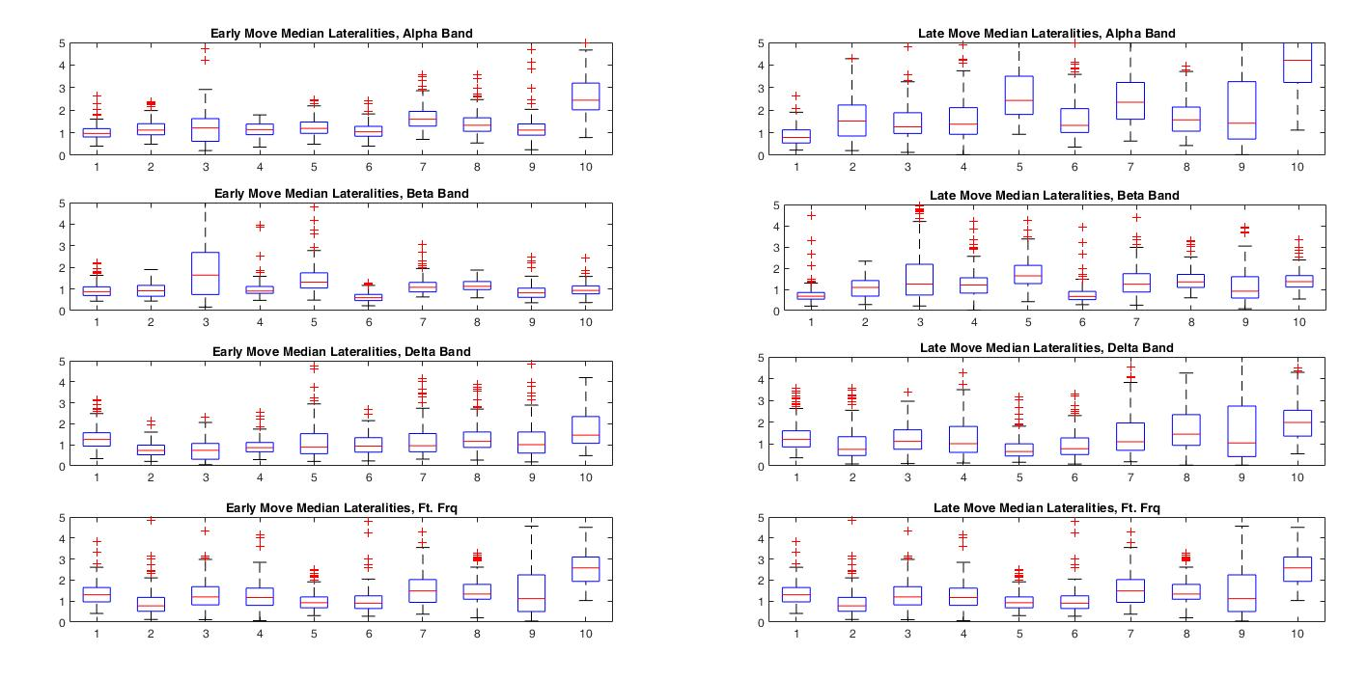
Early v. Late Median Move Lateralities: alpha/beta/delta/ft freqs

Slide 3
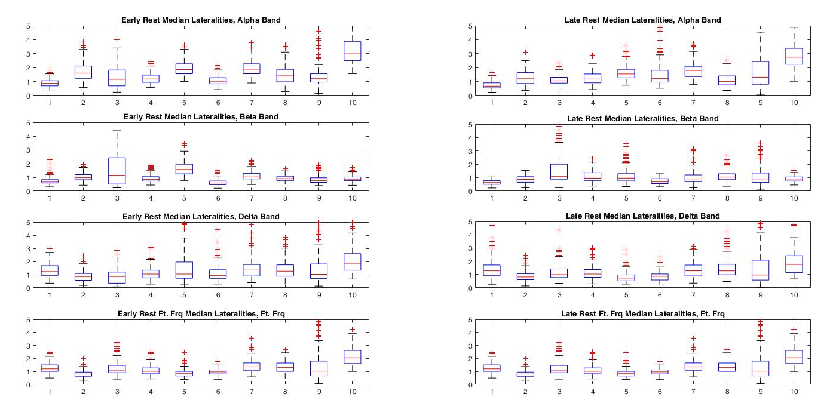
Early v. Late Median Rest Literalities: alpha/beta/delta/ft freqs

Slide 4
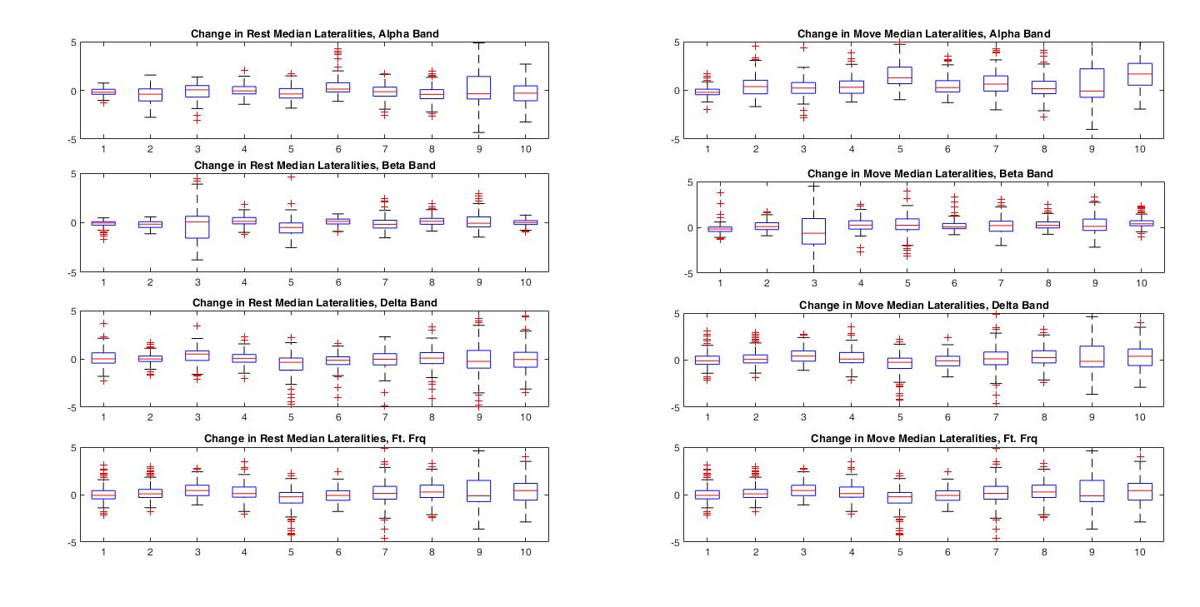
Change in Median Rest and Move Literalities: alpha/beta/delta/ft freqs

Slide 5
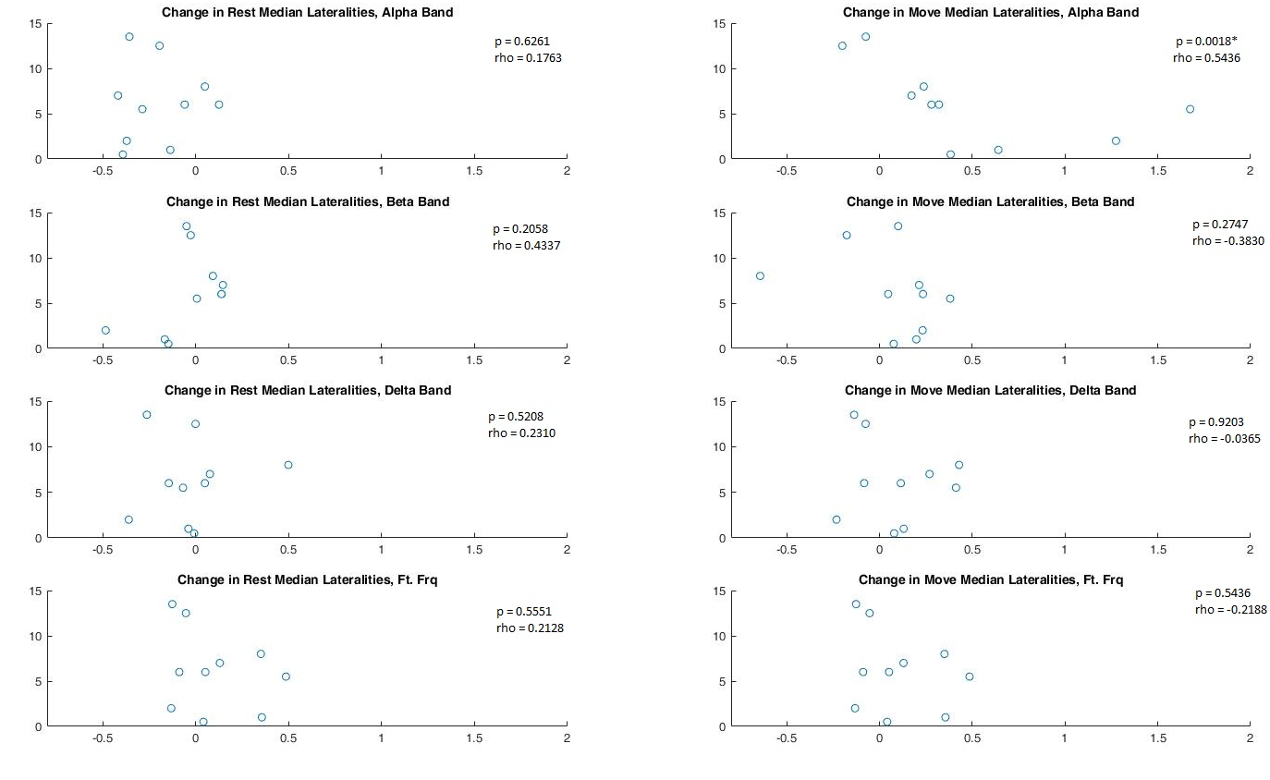
ARAT score change v. Median Rest and Move Laterality change: (alpha/beta/delta/ft freqs)

Slide 6
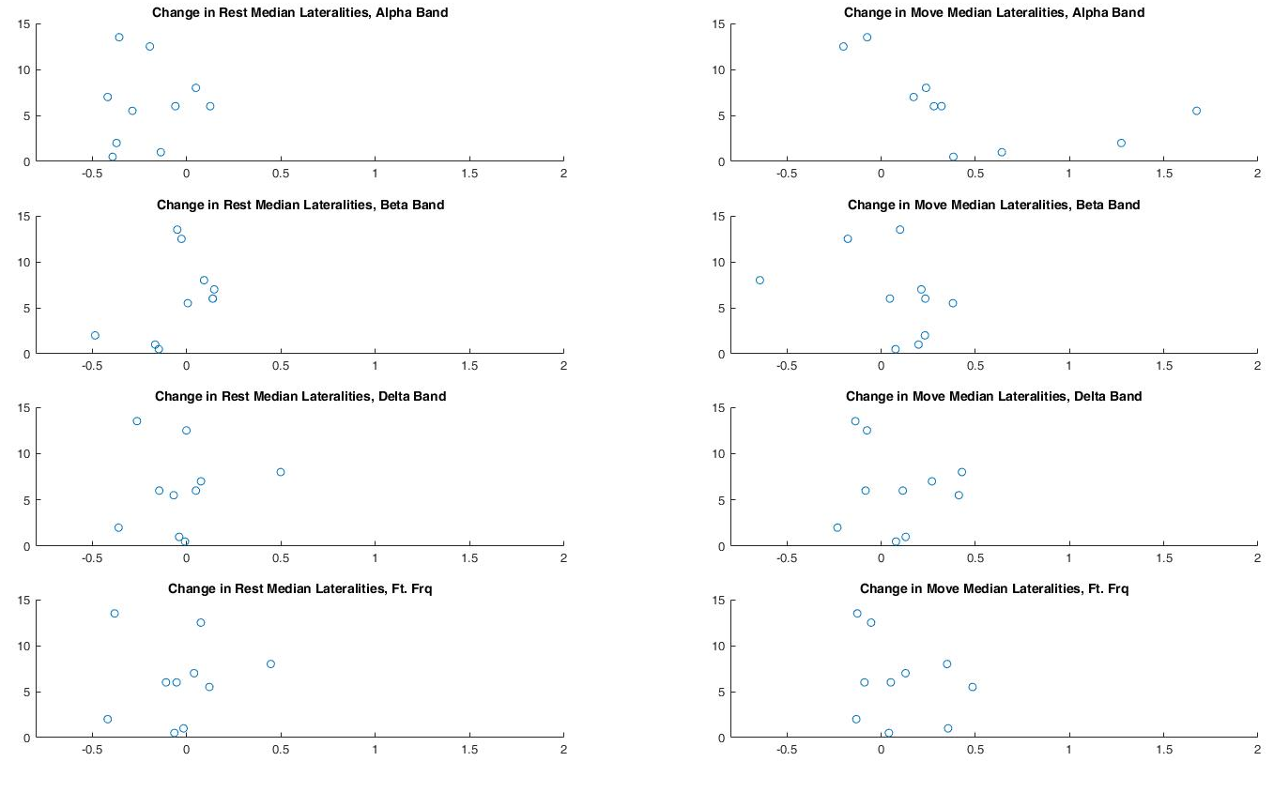
ARAT score change v. Median Rest and Move Laterality change: (alpha/beta/delta/ft freqs, Synchronized X axes)

